Slide 1

Stakeholder Analysis Process and Matrix
Confidential
Created by Management Consultants, previously from Deloitte, McKinsey & BCG

Slide 2





Why should you undertake a stakeholder analysis for your project (or job)?
There are 5 key benefits of conducting a stakeholder analysis for your project (or job):
1. To identify and manage effectively your key stakeholders
2. To get more resources (i.e. people, time or money) by engaging with influential stakeholders
3. To increase the quality of you project by receiving input from stakeholders with high expertise
4. To better communicate the benefits of your project within the company
5. To ensure a better adoption of the change that your project brings

Slide 3
How to undertake a robust stakeholder analysis in 3 simple steps?
1
List stakeholders who can influence your project or be impacted by it
2
Segment your key stakeholders by leveraging our Stakeholder Analysis Matrix in Powerpoint
3
Define & implement a plan of actions for each stakeholder by leveraging our Detailed Stakeholder Analysis Matrix in Excel

Slide 4
Step 1: List stakeholders who can influence your project or be impacted by it
Stakeholders | Influence | Impact
Insert Stakeholder Group name or Stakeholder name | High | High
e.g. Senior executives, Manager, customer, team, shareholders, government | Low | Low
e.g. suppliers, the press, the public, prospective customers, trade associations | High | High
Insert Stakeholder Group name or Stakeholder name | Low | Low
Insert Stakeholder Group name or Stakeholder name
Insert Stakeholder Group name or Stakeholder name
Insert Stakeholder Group name or Stakeholder name
Insert Stakeholder Group name or Stakeholder name
Insert Stakeholder Group name or Stakeholder name
Insert Stakeholder Group name or Stakeholder name
Insert Stakeholder Group name or Stakeholder name
Insert Stakeholder Group name or Stakeholder name
Insert Stakeholder Group name or Stakeholder name
Insert Stakeholder Group name or Stakeholder name
Insert Stakeholder Group name or Stakeholder name
Insert Stakeholder Group name or Stakeholder name

Slide 5
Step 2: Segment your key stakeholders by leveraging our Stakeholder Analysis Matrix
Our high-level Stakeholder Matrix will help you manage your Stakeholders effectively by segmenting your stakeholders into 4 different strategies:
Monitor and Respond
Keep Informed
Collaborate
Maintain Confidence
To identify in which segment your stakeholder belongs, you simply need to rate them based on the following 2 dimensions:
Influence (Extent to which this group or person’s buy-in is needed to move forward)
Impact (Extent to which the project will impact this group/person)

Slide 6
Step 2: Segment your key stakeholders by leveraging our Stakeholder Analysis Matrix
Who must be in contact with the group or person?
Insert name
Insert name
Insert name
high
Maintain Confidence
Collaborate
Put enough work in with these people to keep them satisfied, but not so much that they become bored with your message.
You must fully engage and collaborate with these people, and make the greatest efforts to satisfy them.
Influence
Extent to which this group or person’s buy-in is needed to move forward
Monitor and Respond
Keep Informed
Adequately inform these people, and talk to them to ensure that no major issues are arising. People in this category can often be very helpful with the detail of your project.
Monitor these people, but don’t bore them with excessive communication.
low
Impact Extent to which the project will impact this group/person
high

Slide 7
Step 2: Segment your key stakeholders by leveraging our Stakeholder Analysis Matrix
Who must be in contact with the group or person?
Insert name
Insert name
Insert name
high
Maintain Confidence
Collaborate
Insert Stakeholder Group name or Stakeholder name
Insert Stakeholder Group name or Stakeholder name
Insert Stakeholder Group name or Stakeholder name
Insert Stakeholder Group name or Stakeholder name
Insert Stakeholder Group name or Stakeholder name
Insert Stakeholder Group name or Stakeholder name
Insert Stakeholder Group name or Stakeholder name
Insert Stakeholder Group name or Stakeholder name
Insert Stakeholder Group name or Stakeholder name
Insert Stakeholder Group name or Stakeholder name
Insert Stakeholder Group name or Stakeholder name
Insert Stakeholder Group name or Stakeholder name
Influence
Extent to which this group or person’s buy-in is needed to move forward
Insert Stakeholder Group name or Stakeholder name
Insert Stakeholder Group name or Stakeholder name
Insert Stakeholder Group name or Stakeholder name
Insert Stakeholder Group name or Stakeholder name
Insert Stakeholder Group name or Stakeholder name
Insert Stakeholder Group name or Stakeholder name
Monitor and Respond
Keep Informed
Insert Stakeholder Group name or Stakeholder name
Insert Stakeholder Group name or Stakeholder name
Insert Stakeholder Group name or Stakeholder name
Insert Stakeholder Group name or Stakeholder name
Insert Stakeholder Group name or Stakeholder name
Insert Stakeholder Group name or Stakeholder name
Insert Stakeholder Group name or Stakeholder name
Insert Stakeholder Group name or Stakeholder name
Insert Stakeholder Group name or Stakeholder name
Insert Stakeholder Group name or Stakeholder name
Insert Stakeholder Group name or Stakeholder name
Insert Stakeholder Group name or Stakeholder name
Insert Stakeholder Group name or Stakeholder name
Insert Stakeholder Group name or Stakeholder name
Insert Stakeholder Group name or Stakeholder name
Insert Stakeholder Group name or Stakeholder name
Insert Stakeholder Group name or Stakeholder name
Insert Stakeholder Group name or Stakeholder name
low
Impact Extent to which the project will impact this group/person
high

Slide 8

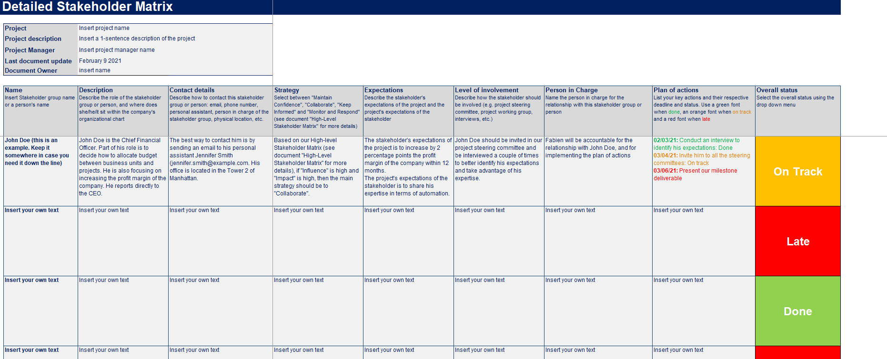
Step 3: Define & implement a plan of actions for each stakeholder by leveraging our Detailed Stakeholder Analysis Matrix in Excel
Access this Excel spreadsheet by opening the document “Detailed Stakeholder Matrix”

Slide 9











Need more help? Our ex-McKinsey, Deloitte & BCG Consultants created 11 Business & Consulting Toolkits
1.Corporate & Business Strategy Toolkit
2.Management Consulting Toolkit
3.Change & Project Management Toolkit
4.Sales, Marketing & Communication Toolkit
5.Financial Planning & Analysis Toolkit
6.Digital Transformation Toolkit
Visit Website
Visit Website
Visit Website
Visit Website
Visit Website
Visit Website
7.Operations & Supply Chain Toolkit
8.Leadership & Personal Development Toolkit
9.Risk Management Toolkit
10.Mergers & Acquisitions Toolkit
11.Entrepreneurship Toolkit
More Toolkits will be created in the coming months.
If you want us to create a specific Toolkit, send us an email at sales@slidebooks.com
Visit Website
Visit Website
Visit Website
Visit Website
Visit Website

Slide 10






Each Business & Consulting Toolkit includes:
Tools
Frameworks
Templates
Support from Tier-1 Management Consultants
Toolkits
Step-by-step Tutorials
Best Practices
Real-life Examples

Slide 11
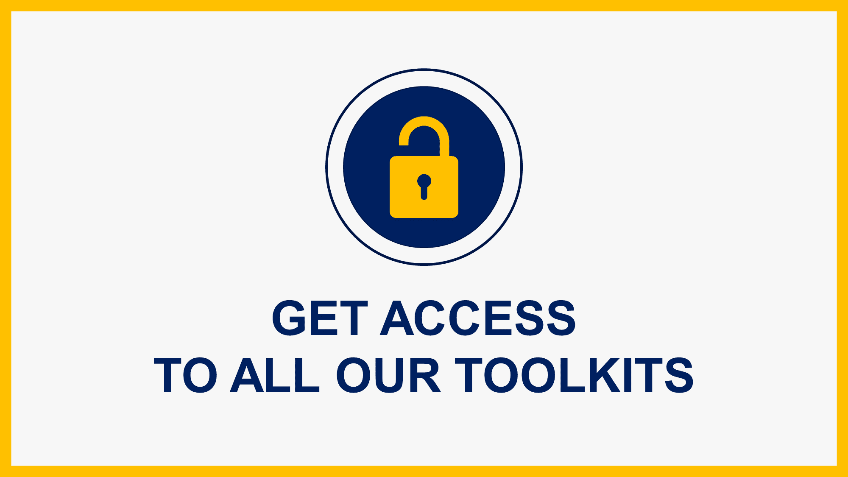
Interested in more than 1 Toolkit? You can access to all our Toolkits for half the price with the Gold Business & Consulting Package
Gold Business & Consulting Package
Learn More
www.slidebooks.com

Slide 12

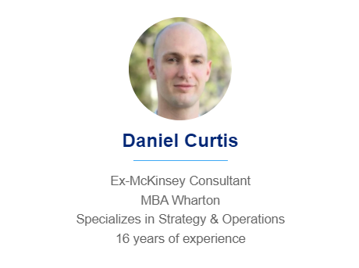
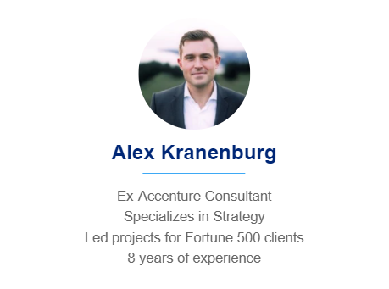



Need more help? Hire one of our Management Consultants for $4,000 a day
See more Management Consultants

Slide 13
Thanks for your attention!
www.slidebooks.com

